Slide 1
Problems with the microscope
40X and 100 X center alignment, 10X, 20X center is not aligned with 40X. → Have to do Kohler alignment every time the top is moved.
Display 20 X → actually 10 X, Display empty → actually 20 X
20X, 40X phase is dirty. Can’t focus.
The stage and the camera is tilted 100 degrees. → fixed
DIC shutter open time, (after focus with GFP, the exposure time for DIC has to be longer) → should be fixed now, the setting for DIC was off
Cannot use DIC for 10X and 20X → no way to fix
GFP bleed through? → should be fixed now, the settings were off
Why do we have to open old protocol change the setting for illumination? → users should not change the settings

Slide 2
 | Settings |  | GFP |  | mCherry1 |  |  | mCherry2 |  |  | mCherry-dim |  |  |  | PhyB_ red_activation
Wavelength |  |  | 0 |  | 620 |  |  | 620 |  |  | 620 |  |  |  | 620
Ti Filter Block 1 |  | v | 5. GFP-L | v | YFPHQ |  | v | TxRed |  | v | YFPHQ |  |  | v | 6. TxRed
Ti Optical Path |  | v | 2. Left Port |  | 2. Left Port |  |  | 2. Left Port |  |  | 2. Left Port |  |  |  | 2. Left Port
Ti Lamp Voltage #2 |  |  | 5.5 |  | 5.5 |  |  | 5.5 |  |  | 5.5 |  |  |  | 5.5
Prior Servo Mode
Lambda Wheel A |  | v | 10. Open | v | 2. 546/11 Orange1 |  | v | 8. 580/10 Cherry2 |  | v | 7. 515/10 Orange2 |  |  | v | 10. Open
Lambda Wheel B |  | v | 10. Open | v | 5. 630/20 Cherry1_dim |  | v | 5. 630/20 Cherry1_dim |  | v | 6. 650/100 Cherry2_Bright |  |  | v | 7. Closed
Ti Lamp Voltage |  | v | Closed | v | Closed |  | v | Closed |  | v | Closed |  |  | v | Closed
Lambda Shutter A |  | v | Active | v | Active |  | v | Active |  | v | Active |  |  | v | Active
Lambda shutter B |  |  | Active |  | Active |  |  | Active |  | v | Closed |  |  | v | Closed

Slide 3
 | Settings |  | GFP |  | mCherry1 |  |  | mCherry2 |  |  | mCherry-dim |  |  |  | PhyB_ red_activation
Wavelength |  |  | 0 |  | 620 |  |  | 620 |  |  | 620 |  |  |  | 620
Ti Filter Block 1 |  | v | 5. GFP-L | v | 5. GFP-L |  | v | 6. TxRed |  | v | 6. Txred |  |  | v | 6. TxRed
Ti Optical Path |  | v | 2. Left Port | V | 2. Left Port |  | V | 2. Left Port |  | V | 2. Left Port |  |  | V | 2. Left Port
Ti Lamp Voltage #2 |  |  | 5.5 |  | 5.5 |  |  | 5.5 |  |  | 5.5 |  |  |  | 5.5
Prior Servo Mode
Lambda Wheel A |  | v | 10. Open | v | 2. 546/11 Orange1 |  | v | 8. 580/10 Cherry2 |  | v | 7. 515/10 Orange2 |  |  | v | 10. Open
Lambda Wheel B |  | v | 10. Open | v | 5. 630/20 Cherry1_dim |  | v | 5. 630/20 Cherry1_dim |  | v | 6. 650/100 Cherry2_Bright |  |  | v | 7. Closed
Ti Lamp Voltage |  | v | Closed | v | Closed |  | v | Closed |  | v | Closed |  |  | v | Closed
Lambda Shutter A |  | v | Active | v | Active |  | v | Active |  | v | Active |  |  | v | Active
Lambda shutter B |  |  | Active |  | Active |  |  | Active |  | v | Closed |  |  | v | Closed

Slide 4
Field measurments
Ruler: 10,000 um (1cm or 10mm) total, 10um (0.01mm) increment
10X objective diameter =2200 um = 2.2 mm
20X objective diameter = 1100 um
40X objective diameter = 530 um
100X objective diameter = 220 um

Slide 5
20X and 40 X, 100X center is not the same location
10X
20X
100X
40X

Slide 6
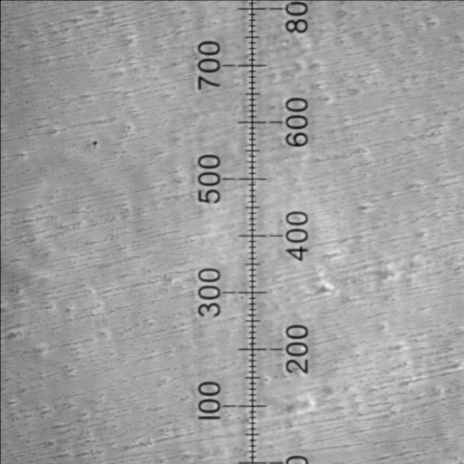
10X

Slide 7
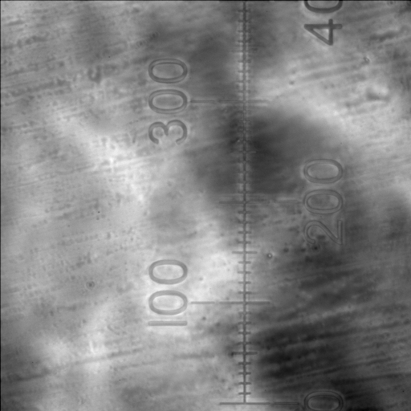
20X

Slide 8
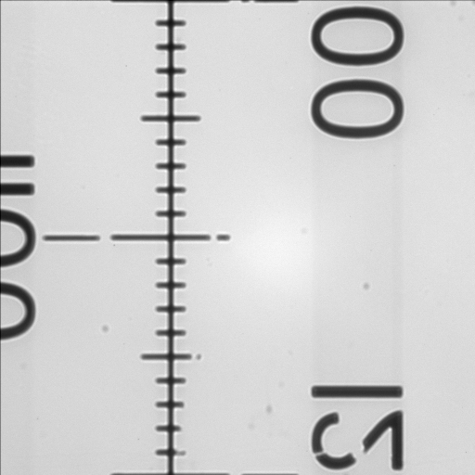
40X

Slide 9
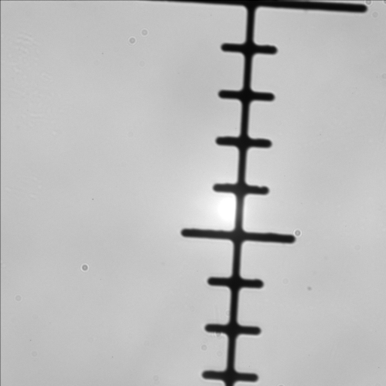
100X

Slide 10
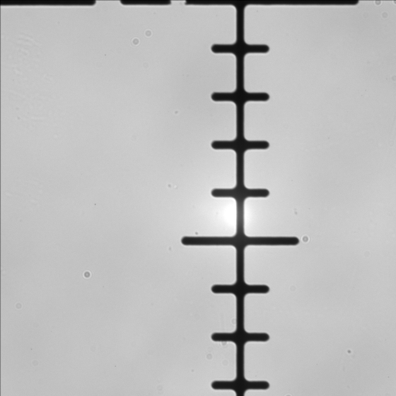
100X_slides rotated

Slide 11
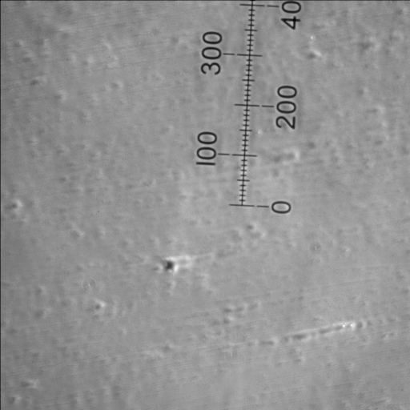
10X zero centered

Slide 12
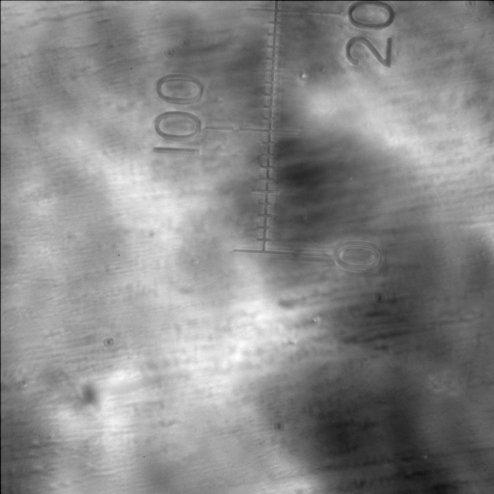
20X zero centered

Slide 13
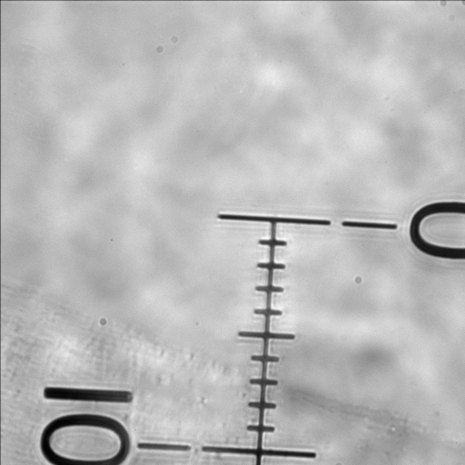
40X zero centered

Slide 14
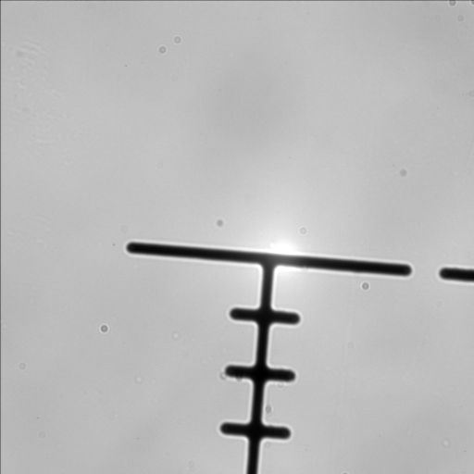
100X zero centered

